Slide 1
The effects of the atomic bomb on civilians and international relations
Name:
INSTITUTION :
DATE :

Slide 2

Historical Lenses and History’s Value
History plays a very significant role in the life of human beings
Ideally, the world as it exists now has been shaped by the experiences of things and events that have happened in the past
These experiences are better understood when historians study them using different approaches call lens
Notes:
History plays a very significant role in the life of human beings. Apparently, most of the social frameworks we have established today have been shaped courtesy of the experiences and the lessons that people have learned from past events. These events are better understood when approached from different historical lenses. Historical lenses in this context refer to the manner in which historians approach the same historical topic. Ideally, this means that the understanding made or the conclusion reached regarding the same topic might vary depending on the lens that a historian took when researching on it. The value of this approach is that it explains the topic in different context thus making it easier to comprehend.

Slide 3
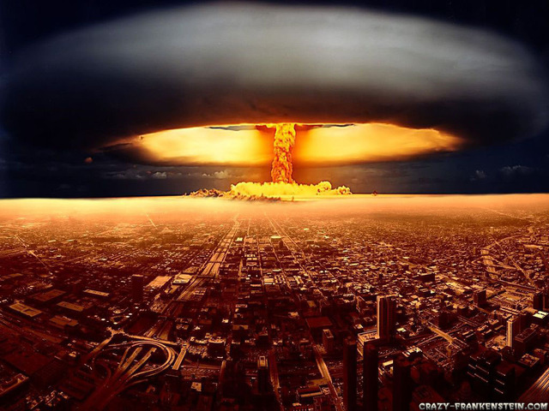
My topic
My topic revolves around the effects of the atomic bomb on civilians and international relations
Atomic bomb is a nuclear explosive that causes mass destruction like in the case of Hiroshima and Nagasaki
The bombs were major defining moment in the history of humanity basing on the huge impact that it had both locally and internationally
Notes:
My research topic revolves around the effects of the atomic bomb on civilians and international relations. For my research, I will explore the bombs which were an attack on the stubborn Japan by the US that was so eager to end the ensuing international conflict. It was dropped in Hiroshima and Nagasaki in August of 1945 during the World War II. According to Brooks and Stanley (2007), this was a major defining moment in the history of humanity as it left long-lasting effects not only on the people directly affected by it, but also their friends, families and relations. The impact was so big, forcing Japan to surrender and subsequently an end to the World War II.

Slide 4
Three historical lenses
Historical refers to the manner in which historians approach the same topic
There are three major historical lenses used today
Economic lens – looks at the business aspect of a topic
Social lens – focuses on the interaction of people and their social settings
Political lens – explores governments, leaders and forms of governance
Notes:
As highlighted earlier, historical lens refers to the manner in which historians approach the same topic. Apparently, historical events or occurrences often carry a lot of meanings when reviewed from different points of view. There are numerous historical lenses used today. Nonetheless, the three major categories include: social, economic and political lenses. Social lens focuses on the interaction of people, their ethnicity, social classes and gender. Economic lens on the other hand studies an event in relation to how it interferes with business and national or international economies. Finally, political lens explores governments, leaders and forms of governance. It also takes into consideration how policies impact legislation, regulations and power.

Slide 5
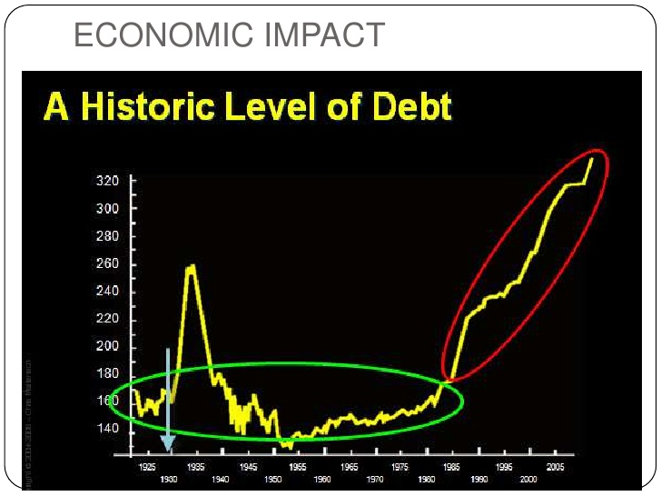
Lens 1: Economic effects of atomic bomb on civilians and international relations
Atomic bombs often result in mass destruction
All infrastructure and physical setting of an area are destroyed hence taking the country to square zero
The massive loss of life deprives countries of manpower that is crucial for economic development
Notes:
Atomic bombs have the capabilities of mass destruction. As such, their detonation often has significant economic effects on areas affected. According to Hoyt (2011) for instance, these bombs completely destroy infrastructure and the physical setting hence resulting in huge economic loss. Countries are literally taken to square zero where they have to start developing from scratch. The significant loss of life also implies that the areas or countries affected are deprived of manpower that is very crucial in building the economy of a nation. In addition, people that are crippled by the bombings may become incapacitated hence lose their jobs.

Slide 6
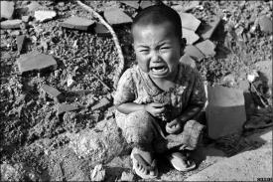
Lens 2: Social effects of atomic bomb on civilians and international relations
The biggest social effect of atomic bombs is massive loss of lives
Like in Japan, these bombs are characterized by high fatality rates with the number of casualties running into hundreds of thousands
Post-bomb cancers due to radiations
There is also massive psychological damage on survivors
Notes:
The biggest effect of atomic bombs is massive loss of live. In Hiroshima and Nagasaki for instance, more than 200,000 people lost their lives. This number demonstrates the bomb’s capabilities of wiping away an entire generation. As Miles (1985) indicates, the resulting deaths usually impact negatively on the society as it distorts social settings such as families and communities. The deadly radiations from the bombings also live on to affect future generations further jeopardizing their wellbeing. In Hiroshima for instance, there were increased complaint among survivors of neurotic symptoms such as amnesia, fatigue and lack of concentration. This signified massive psychological damage.

Slide 7
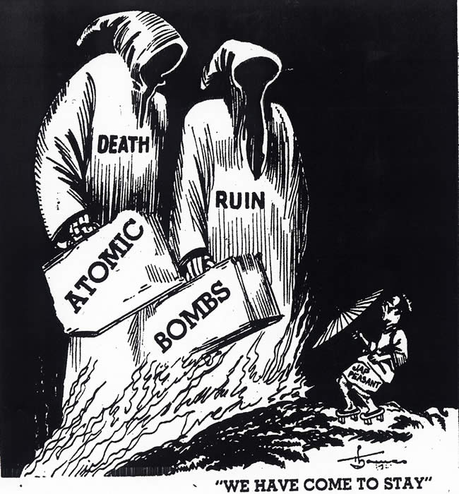
Lens 3: Political effects of atomic bomb on civilians and international relations
Massive loss of lives and infrastructure can destroy the political frameworks and systems that govern a country
This may create political instability especially when there exists a power vacuum
Globally, international relations are jeopardized as the bombings create friends and enemies thus sparking outrage and setting recipe for world war
Notes:
Political instability is the main political consequence that follows a massive loss of both life and infrastructure caused by atomic bombs. According to Mallory (2012), such level of destruction can shake the political frameworks and systems hence incapacitating a country’s ability to self-govern. In cases where a power vacuum is created, political wars may arise as different parties strive to clinch power. This may create room for terrorism to thrive. On the international scene, foreign relations are adversely affected (Miles, 1985). Atomic bombings can create international enemies and groupings as different countries either side with the attacker or attacked. This sparks outrage hence creating recipe for world war.

Slide 8
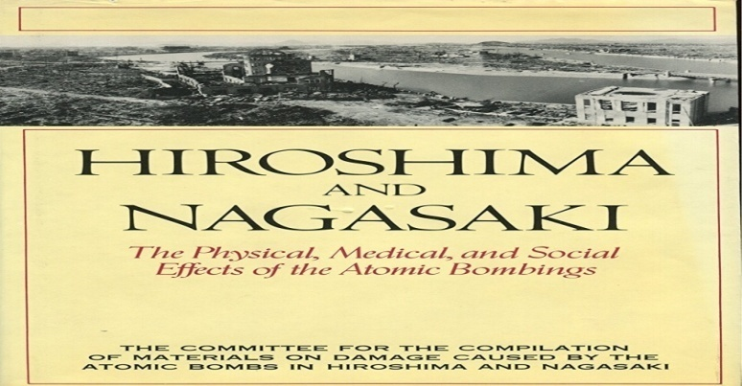
Historical narrative – Hiroshima and Nagasaki atomic bombings
The bombings of Hiroshima and Nagasaki in Japan are a perfect example of nuclear war and how it impacted humanity
The bombs were dropped by the US to force an end to the World War II
The plan worked as Japan surrendered after suffering massive destruction
Notes:
Atomic bombing of Hiroshima and Nagasaki marked the end of World War II that had lasted for close to six years. Japan was one of the key players in the conflict, backing Nazi Germany in its quest to conquer Europe (Brooks & Stanley, 2007) The United States joined the war as an ally of UK and Britain that were on the other side of the conflict. The US dropped the world’s deadliest bombs on Hiroshima and Nagasaki three days apart with the objective of wanting to force Japan into surrendering. Apparently, it had been running a nuclear weapons development program and was so eager to test the bombs in real war.

Slide 9
Our lives
The life of a person is a fundamental right that cannot be taken away whatsoever
The destruction the Japan suffered under the attack of the US served to demonstrate how lethal nuclear weapons are
Ideally, the UN has put a lot of restrictions on the development of these weapons of mass destructions so as to avoid further massive loss of lives
Notes:
Human life is of great significance. According to Reynolds and Lynch (1955), this life is paramount perhaps explaining why such wars and conflicts like the bombings of Hiroshima and Nagasaki were harshly condemned. It is indeed unacceptable to destroy human life on large scale as the United States did. It has taken Japan ages to redevelop especially having suffered massive loss of both lives and infrastructure. Following the aftermath and the effects of the bombings, the United Nations has been very strict on the development of nuclear weapons. Not all countries are allowed to pursue such weapons of mass destruction

Slide 10
History’s value
History is very crucial because it literally defines humanity
People are generally able to put up strong communities courtesy of having knowledge of the past and making sense of what has happened
History also gives us a sense of identity and critical skills
Notes:
History has a lot of values. Hoyt (2011) notes that there a lot of benefits for having knowledge of the past as well as the practice of researching and making sense of what happened in the past. For instance, this knowledge lays the groundwork for strong, resilient communities. A lot of lessons are learned from mistakes that have been done in the past. By avoiding these mistakes, communities are able to set up better frameworks both for governance and economic development. At a personal level, history is able to instill in individuals a sense of identity as well as critical skills of how to approach issues in life.

Slide 11

Does history repeat itself? My opinion
Whether history repeats itself or not still remains a controversial topic
According to me however, I believe that it does not precisely repeat itself but rather follows a certain type of repeated episodic determinism
A perfect example is how the first and second world wars were triggered by nearly the same factors and proceeded in nearly the same way
Notes:
The question of whether history repeats itself still remains a controversial one. There have been valid debates that have seemed to justify each side of the divide. According to me however, I do not agree that it does repeat itself precisely. Nonetheless, it is full or stories confirming a certain type of repeated episodic determinism. For instance, when you study the first and second world wars, you find that both conflicts were triggered by nearly the same factor i.e. pursuant of power and global dominance.

Slide 12
Does history repeat itself? – Evidence from the course
History does not literally repeat itself
However, it follows broad patterns
These patterns can be well understood in the context of causes and effects relationship
An event such as war is likely to reoccur if the causing factors appear twice
Notes:
History does not literally or exactly repeats itself. However, it does so following broad patterns. Ideally, this is what historians imply when the use the phrase. According to Mallory (2012) the patterns in this context is in relation to the cause and effect relationships. Events such as war or vices like racism, sexism and poverty occur due to the existence of some factors. If these factors are re-introduced again the same events are bound to happen creating the impression that history repeats itself. In the US for instance, the country raised serious economic concerns following the influx of Chinese and Jews immigrants in 1850s and 1920s respectively. The same thing is happening now with many of the American troubled at the high numbers of Mexicans moving into the country.

Slide 13

Are citizens obligated to know history?
Citizens should be obligated to learn history
This is because there are a lot of benefits in having knowledge of the past
We are generally able to make sense of the things happening now because history answers most of the why and how questions
Notes:
Citizens should be obligated to learn history. As indicated earlier, there are a lot of benefits in one having knowledge of what happened in the past. As Reynolds and Lynch (1955) demonstrate for instance, knowing your history provides incredible insights into a number of things including causes and effects, concepts and ideas and the general human nature. Such knowledge enables the current generation to create co-relation with events or actions that are happening now. In other words, making sense of what happened in the past presents reasons for why and how questions thus giving us a better understanding of where we have come from as humanity.

Slide 14
References
Brooks, R. & Stanley, E. (2007). Creating Military Power: the Sources of Military Effectiveness. Stanford, California: Stanford University Press.
Hoyt, E.P. (2011). Japan's War: The Great Pacific Conflict. New York: McGraw-Hill.
Miles, R. E., Jr. (1985). Hiroshima: The strange myth of half a million American lives saved. International Security, 10(2), 121-140.
Mallory, S. L. (2012). ‘A very pleasant way to die’: Radiation effects and the decision to use the atomic bomb against Japan. Diplomatic History, 36(3), 515-545.
Reynolds, M. L. & Lynch, F. X. (1955). Atomic bomb injuries among survivors in Hiroshima. Public Health Reports, 70(3), 261-270.

